Slide 1


Docker and Kubernetes
2018-10-17 – Mark Hahn, DevOps Director
Mhahn@ciber.com ; 425-749-9501

Slide 2
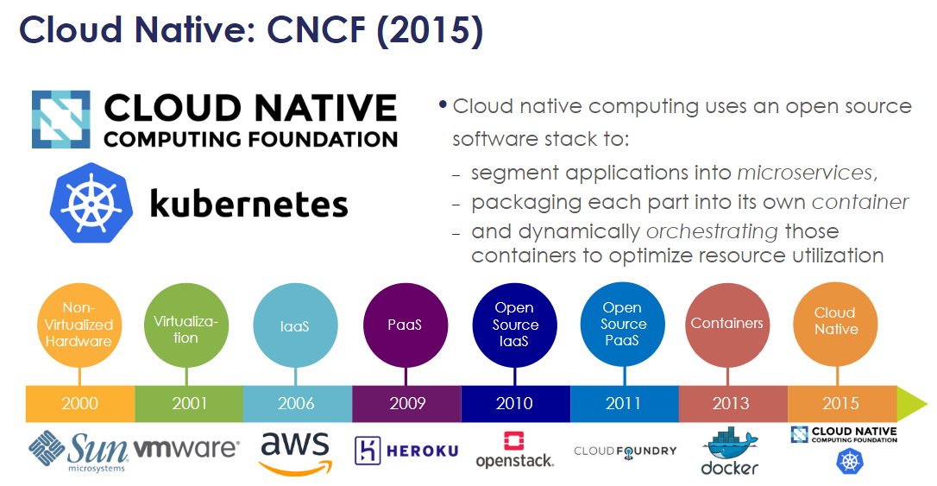
History

Slide 3
Sources
https://github.com/cncf/presentations/tree/master/kubernetes
The above slide is from a 2017 presentation by Dan Kohn, Migrating Legacy Monoliths to Cloud Native Microservices Architectures on Kubernetes
https://docs.google.com/presentation/d/105ZgwafitwXH6_sWevFHHUerciuv4ckDQ_CXjGPjv0Y
O’Reilly Safari
Kubernetes for Developers by Joseph Heck
Kubernetes in Action by Marko Lukša

Slide 4
More Reading for the Interested
O’Reilly
Docker: Up & Running, 2nd Edition by Karl Matthias , Sean P. Kane
Docker Cookbook - Second Edition by Neependra K Khare , Jeeva S. Chelladhurai , Ken Cochrane
Introducing Istio Service Mesh for Microservices by Burr Sutter , Christian Posta
Spring: Microservices with Spring Boot by Ranga Rao Karanam
Note:
You should be a member of the ACM, Association of Computing Machinery
Or the IEEE Computer Society

Slide 5
Containers vs VMs
https://www.slideshare.net/TruongLd/docker-get-started?qid=94a83783-5d31-4781-8a94-e5c3ca20f00f
App A
App A*
App B
Containers are isolated but share OS and, where appropriate, bins/libraries
Bin/ Libs
Bin/ Libs
Bin/ Libs
App A
App A*
App B
App B
App B
App B
Guest
OS
Guest OS
Guest OS
Docker
Bin/ Libs
Bin/
Libs
Hypervisor
Host OS
Host OS
Server
Server

Slide 6
Containers vs VMs
https://www.slideshare.net/TruongLd/docker-get-started?qid=94a83783-5d31-4781-8a94-e5c3ca20f00f
App A
App A*
App B
Containers are isolated but share OS and, where appropriate, bins/libraries
Docker
Bin/ Libs
Bin/ Libs
Bin/ Libs
App A
App A*
App B
App B
App B
App B
Guest
OS
Guest OS
Guest OS
Docker
Bin/ Libs
Bin/
Libs
Hypervisor
Host OS
Host OS
Server
Server

Slide 7
Docker Process
Compose
Push
Pull
Build
Store in Registry
Run

Slide 8
Docker Compose
Take a previous image
Add application specific details
And application WAR file
Storage
Network configuration
Etc.
Create the new image
Similar in concept to “Hibernating” a running Windows system
Memory and state are saved to disk
Restart is fast

Slide 9
Dockerfile – for mark’s lemonade stand sample app
FROM java:8-jdk
RUN mkdir workspace
WORKDIR workspace
ADD ./build/libs/lemonade-supply-0.1.0.jar app.jar
EXPOSE 8080
CMD java -jar ${ADDITIONAL_OPTS} app.jar

Slide 10
Docker Push
Storing the new image
Local to system that built it
Privately to a central on premise server
Artifactory
GitLab
Publicly to a common server
DockerHub
Just a big database of saved images
Ways to search

Slide 11
Docker Run
Retrieves saved image
From local system
Or from a central repository
Network transmission time is the dominate factor
Starts the image
Reasonably fast, tenths of seconds to under 10 seconds
Container – when it’s running it’s a container
Strict Isolation of the running image
Does not share resources with any other process
Built on a security isolation mechanism

Slide 12
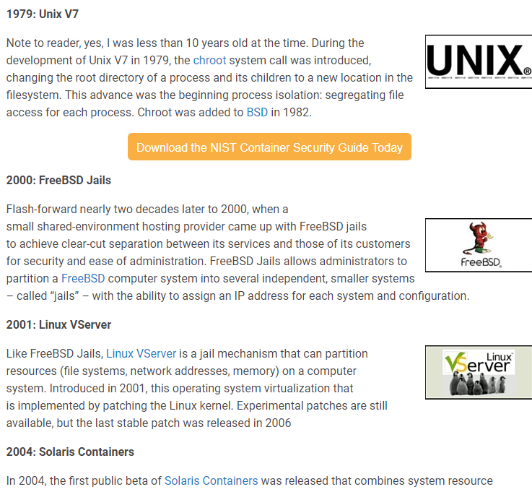
Secure Container History
https://blog.aquasec.com/a-brief-history-of-containers-from-1970s-chroot-to-docker-2016

Slide 13
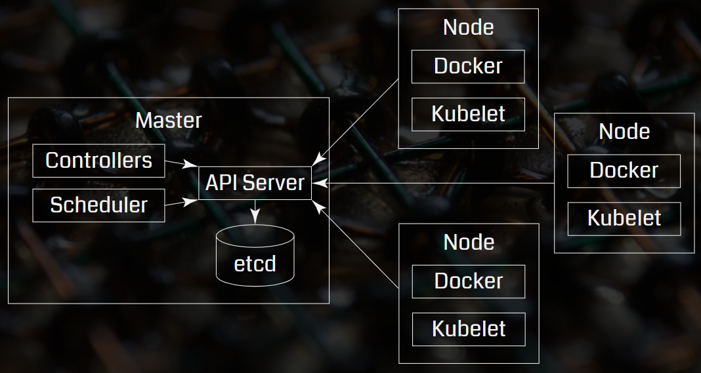
Kubernetes Architecture

Slide 14
Kubernetes Architecture – Developers Don’t Care
App A
App A*
App B
App B
App B
App B
This is what you care about

Slide 15
How to get from zero to Kubernetes running my app
Route 1:
Create a Cluster (manually)
Deploy (manually)
Route 2:
Create a Cluster (manually)
Share some auth tokens (manually)
CI/CD Deployments

Slide 16
Kubernetes Objects
Basic Objects:
Pod
Service
Volume
Namespace
Controllers:
ReplicaSet
Deployment
StatefulSet
DaemonSet
Job

Slide 17
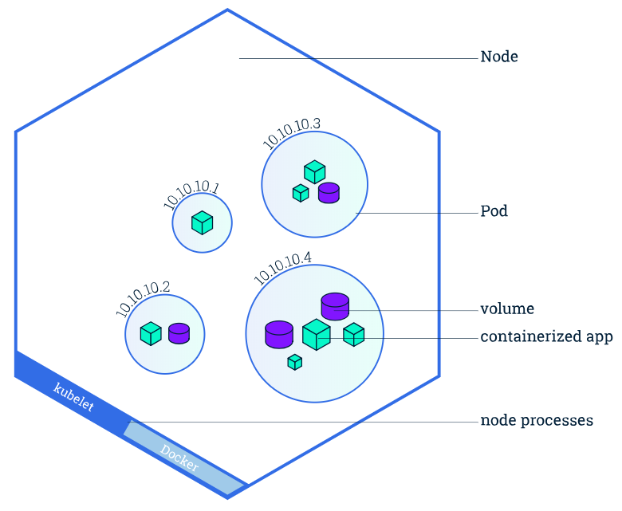
Nodes and Pods
https://kubernetes.io/docs/tutorials/kubernetes-basics/explore/explore-intro/#node-overview

Slide 18
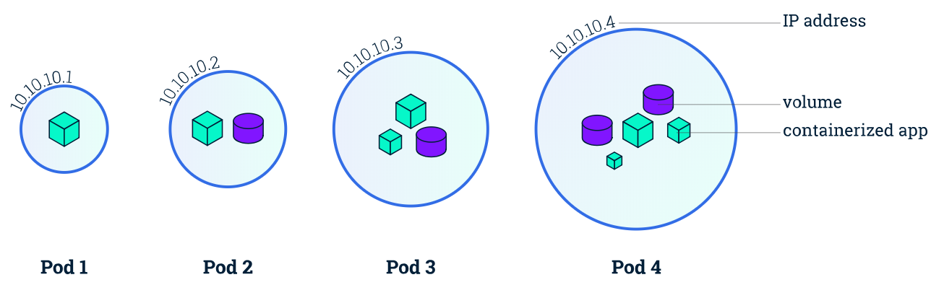
Pod - https://kubernetes.io/docs/concepts/workloads/pods/pod-overview/
All the containers for a Pod will be run on the same Node
Any container running within a Pod will share the Node's network with any other containers in the same Pod
Containers within a Pod can share files through volumes, attached to the containers
A Pod has an explicit life cycle, and will always remain on the Node in which it was started

Slide 19
Pod Use Case
Pods that run a single container. The “one-container-per-Pod” model is the most common Kubernetes use case; in this case, you can think of a Pod as a wrapper around a single container, and Kubernetes manages the Pods rather than the containers directly.
Pods that run multiple containers that need to work together. A Pod might encapsulate an application composed of multiple co-located containers that are tightly coupled and need to share resources.
These co-located containers might form a single cohesive unit of service–one container serving files from a shared volume to the public, while a separate “sidecar” container refreshes or updates those files. The Pod wraps these containers and storage resources together as a single manageable entity.

Slide 20
Volume
Provides a persistent file system to a Pod
Lives as long as the Pod
More than 2 dozen types
Azure specific
AWS (EBS) specific
Secret
Can be local to the node, or pod
Can be global

Slide 21
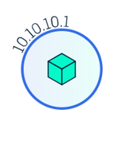
Service - https://kubernetes.io/docs/concepts/services-networking/service/
Defines a logical set of Pods and a policy by which to access them - sometimes called a micro-service.
HTTTP over TCP on Port 80
Service
Load balancing
Across Pods
Node 1
HTTTP over TCP on Port 8080
ReplicaSet
Of containers
Pod 1
Pod 2

Slide 22
Namespace
Everything has a name
Namespaces allow these to be grouped to prevent conflicts
See also labels and annotations

Slide 23
Kubernetes Objects
Basic Objects:
Pod
Service
Volume
Namespace
Controllers:
ReplicaSet
Deployment
StatefulSet
DaemonSet
Job

Slide 24
ReplicaSet
A ReplicaSet wraps Pods, defining how many need to run in parallel. A ReplicaSet is commonly wrapped in turn by a deployment. ReplicaSets are not often used directly, but are critical to represent horizontal scaling—to represent the number of parallel Pods to run.
A ReplicaSet is associated with a Pod and indicates how many instances of that Pod should be running within the cluster.

Slide 25
ReplicaSet - https://kubernetes.io/docs/concepts/workloads/controllers/replicaset/
A ReplicaSet ensures that a specified number of pod replicas are running at any given time.
However, a Deployment is a higher-level concept that manages ReplicaSets and provides declarative updates to pods along with a lot of other useful features.
Update the pods of frontend by just changing the image, and keeping the old name.
kubectl rolling-update frontend --image=image:v2
Rollout
kubectl rollout status daemonset/foo

Slide 26
Deployment
A Deployment controller provides declarative updates for Pods and ReplicaSets.
You describe a desired state in a Deployment object, and the Deployment controller changes the actual state to the desired state at a controlled rate.

Slide 27
Deployment - deployment.yaml
apiVersion: apps/v1 # for versions before 1.9.0 use apps/v1beta2
kind: Deployment
metadata:
name: nginx-deployment
spec:
selector:
matchLabels:
app: nginx
replicas: 2 # tells deployment to run 2 pods matching the template
template:
metadata:
labels:
app: nginx
spec:
containers:
- name: nginx
image: nginx:1.7.9
ports:
- containerPort: 80

Slide 28
StatefulSet - https://kubernetes.io/docs/concepts/workloads/controllers/statefulset/
Manages the deployment and scaling of a set of Pods
Provides guarantees about the ordering and uniqueness of these Pods.
StatefulSets are valuable for applications that require one or more of the following.
Stable, unique network identifiers.
Stable, persistent storage.
Ordered, graceful deployment and scaling.
Ordered, automated rolling updates.

Slide 29
StatefulSet - https://kubernetes.io/docs/concepts/workloads/controllers/statefulset/
The storage for a given Pod must either be provisioned by a PersistentVolume Provisioner based on the requested storage class, or pre-provisioned by an admin.
https://github.com/kubernetes/examples/blob/master/staging/persistent-volume-provisioning/README.md
Deleting and/or scaling a StatefulSet down will not delete the volumes associated with the StatefulSet. This is done to ensure data safety, which is generally more valuable than an automatic purge of all related StatefulSet resources.

Slide 30
More stuff
Open Container Initiative (OCI) (https://www.opencontainers.org).
https://www.cncf.io/projects/
https://xebialabs.com/periodic-table-of-devops-tools/
https://speakerdeck.com/thockin/kubernetes-understanding-pods-vs-containers
https://github.com/kelseyhightower/kubernetes-the-hard-way
https://kubernetes.io/blog/2017/11/kubernetes-easy-way/
Chaos Theory
Chaos Monkey (Netflix)
Mandelbrot

Slide 31
QUESTIONS

Slide 32
Questions
1. for a 10 node deployment for a web service - which is using the load balancing service - where is the service deployed?
Nodes = Machine
Pod = Deployed instance of the App
Replicas = # copies of a given app or service
how the request gets routed to service and then to pods?
what if the node which has the pod with service crashes?

Slide 33
Questions
1. for a 5 node (replica) deployment for a web service - which is using the load balancing service - where is the service deployed? how the request gets routed to service and then to pods?
Nodes = Machine
Pod = Deployed instance of the App
Replicas = # copies of a given app or service
Ip 195.x.x.x
Cluster Router
Service
layer
Ip 10.x.x.x
Ip 10.x.x.x
Ip 10.x.x.x
Pods in a deployment

Slide 34
Questions
1. Answer: The Service is the network Routing that is managed by the Cluster (Kubernetes) to route external IP addresses to the private IP addresses on individual nodes (machines). The nodes (machines) then use iptables to route the traffic to the right pods and containers.
See: https://kubernetes.io/docs/concepts/services-networking/service/
Ip 195.x.x.x
Cluster Router
Service
layer
Ip 10.x.x.x
Ip 10.x.x.x
Ip 10.x.x.x
Pods in a deployment

Slide 35
Questions
1, Part 2: What if the node which has the pod with service crashes?
The kubelet will see the dead node.
Note: dead can mean lots of different things: container exits, the health check fails in some way, etc.
Sends information back to the cluster Master
Master makes a decision: start a new node, forget about it, etc.
Master informs some Kubelet what to do (not necessary the same kubelet)
Node
Ip 10.x.x.x
Kubelet

Slide 36
Node Dies
Green, replicas = 2
Blue, replicas = 3
Master
Node
Ip 10.x.x.x
Node
Ip 10.x.x.x
Kubelet
Kubelet

Slide 37
Node Dies – Master decides this:
Master
Master
Green, replicas = 2
Blue, replicas = 3
Node
Ip 10.x.x.x
Node
Ip 10.x.x.x
Kubelet
Kubelet

Slide 38
Questions
2. There are all kinds of docker images available such as mongodb, reddis cache, jenkins, etc. what kind of docker images are not best suited to be run on k8 or even docker. Additionally are there any example of software, etc which arenot suited for docker.
Persistent State applications (i.e. data bases) need to be engineered differently
You can, and indeed should, run reddis, Mongodb, etc on Kubernetes. Just use the proper patterns and infrastructure.

Slide 39
Most enterprise patterns look like this:
Kubernetes
DBA Team
Oracle
Clients
Mongo
Not allowed

Slide 40
Could it be this:
Kubernetes
Oracle DBA Team
Oracle
Clients
Cassandra DBA Team
Cassandra
Mongo
Tolerated

Slide 41
Questions
3. if we want to run jenkins on k8, how to keep the jenkins data persisted between pods/crash/etc.
Answer: the Jenkins-X project can be deployed via command line and understands how to persist it’s data, using persistent volumes
Answer 2: The CloudBees installation from the Kubernetes marketplace also knows how to persist it’s data. Licensing may apply or set limit on free use.

Slide 42
Questions
4. can databases on k8 be scaled with multi pod configuration?
Compared with 4 node cassanda cluster - how is 4 node k8 cassandra cluster is different?
Answer: A Cassandra cluster deployed on Kubernetes defines the persistence layer, the storage, differently from the computational layer.

Slide 43
Unused Slides

Slide 44
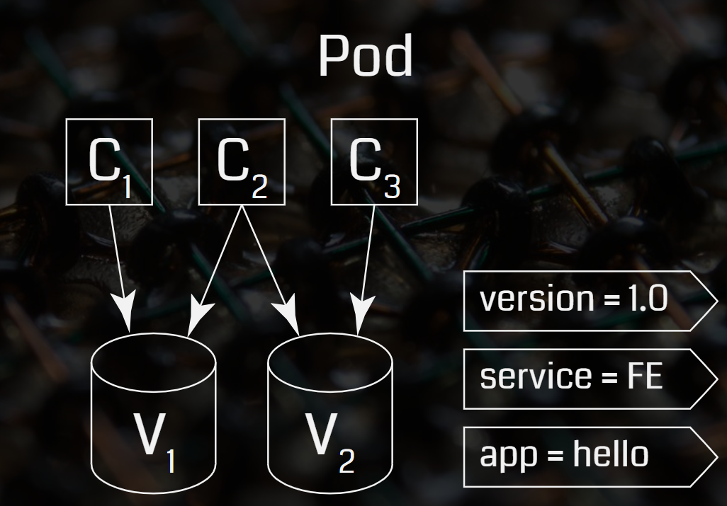

Slide 45
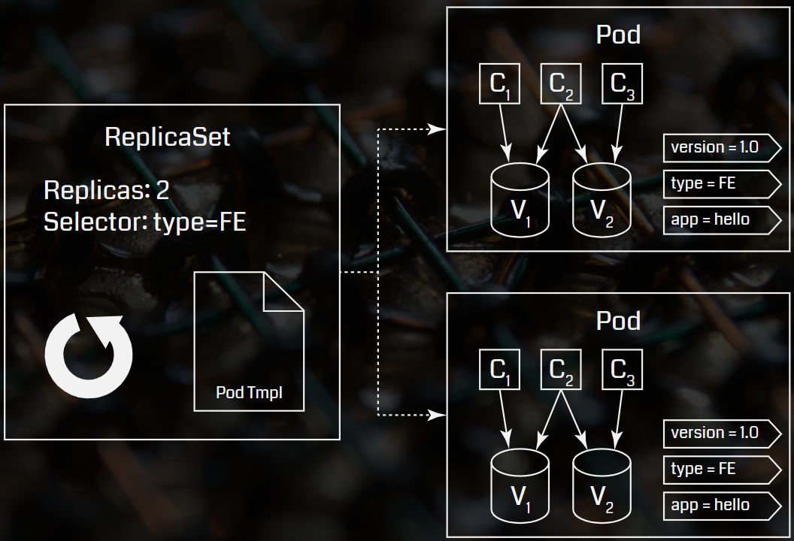

Slide 46

Headquarters
3270 West Big Beaver Road
Troy, MI 48084, U.S.A
Phone: 248.786.2500
Toll-free: 833-609-4950
Honesty Humility Simplicity
www.ciber.com
Reimagine technology to accelerate your business

